Slide 1
YouTube Trending Video Statistics using Tableau
By Ahiri Mukherjee
Source of data:- https://www.kaggle.com/datasets

Slide 2
PROBLEM STATEMENTS
Trend day count per Category ID
Likes and Dislikes per Ctergory ID
Trending tag total per C.Id and Last trending Date
No. of subscriber per Year
Publish date wise Max Publish hour
No. of subscribers
C.Id wise Tag count
Comments disabled and Ratings disabled

Slide 3
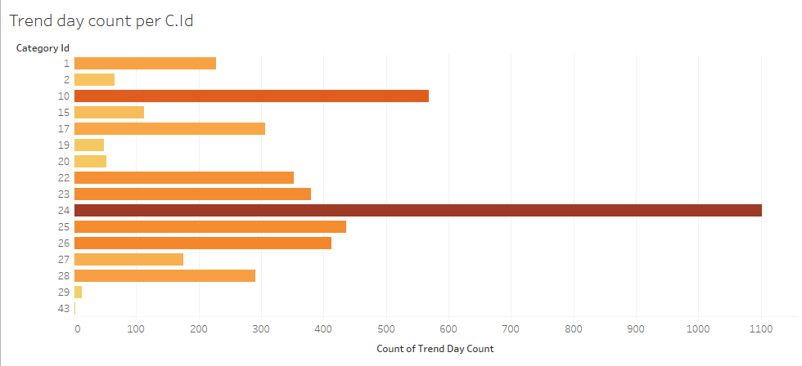
Trend day Count per Category ID
This column chart here shows the trend day count per Category ID.
From the graph we can see that the category ID 24 has the highest Trend day count.

Slide 4
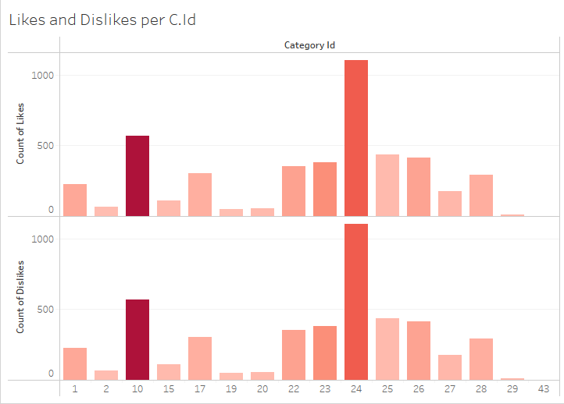
Likes and Dislikes per Category ID
This bar chart shows the count of Likes and Dislikes according to the Category ID.
Here as well, the category ID 24 has the highest number of likes as well as dislikes.
And, the category ID 43 has the lowest number of likes and dislikes.

Slide 5
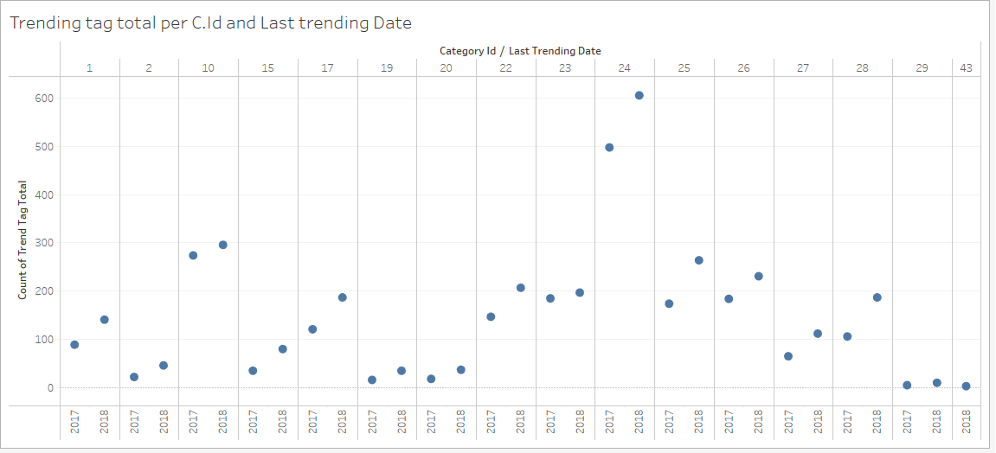
Trending Tag Total per C.ID and Last Trending Date
This is a scatter plot that shows the Trending tag total per Category Id and last trending date.
The data points scattered over the cartesian plane show the Tags that are trending the most according to the last trending date, based on the Category Id, since that’s the unique id to distinguish the data points.

Slide 6
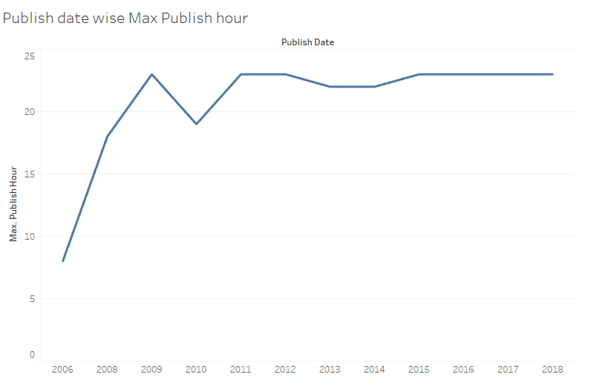
Publish Date wise Max Publish Hour
The line Chart shows the trend line for the Maximum of Publish hour varied according to the Publish Date.
For this chart we created a parameter, i.e., the Maximum of Publish hour and compared the data with the publish date to obtain this line graph.

Slide 7
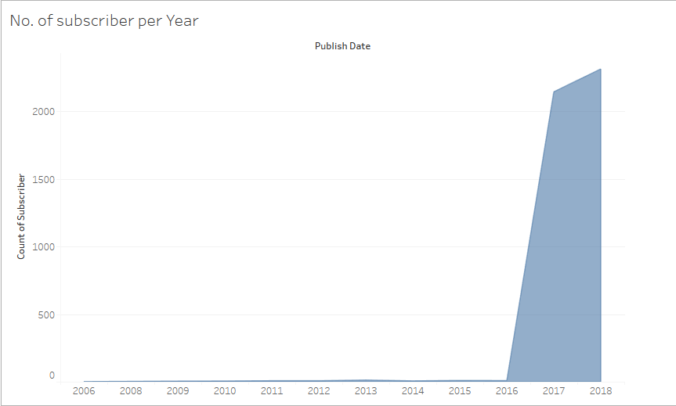
Number of Subscriber per Publish Date(Year)
This Area Chart shows the number of subscribers per publish date (Year).
Here, we can see that the count of YouTube subscribers have increased from 2016 to 2018, and reached a maximum in the year 2018.
The subscriber count was the lowest during 2006 to 2015.

Slide 8
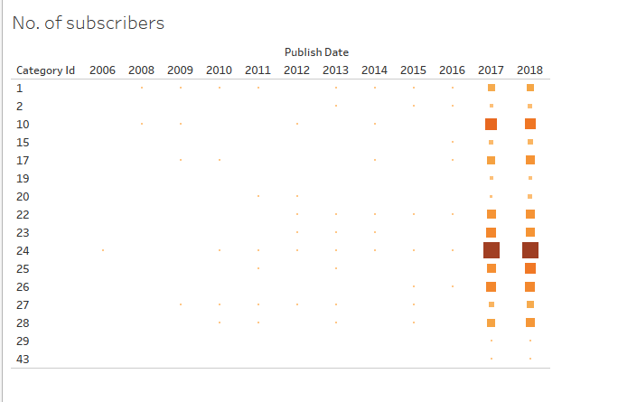
Number of Subscribers
The heatmap here shows the Youtube subscriber Count over the Years 2006 to 2018.
The years 2017 and 2018 have the highest subscriber count and 2006 has the lowest.

Slide 9
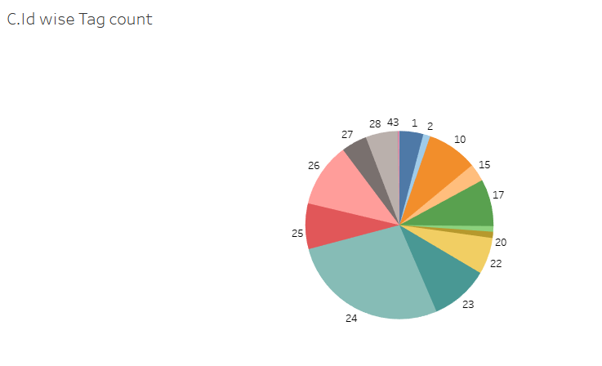
Category ID wise Tag Count
This Pie-chart shows the Trending tag count according to the category ID, as that’s the unique id to distinguish the data.
Similarly, like the previous charts here also we can see that the category Id 24 has the highest Tag count.

Slide 10
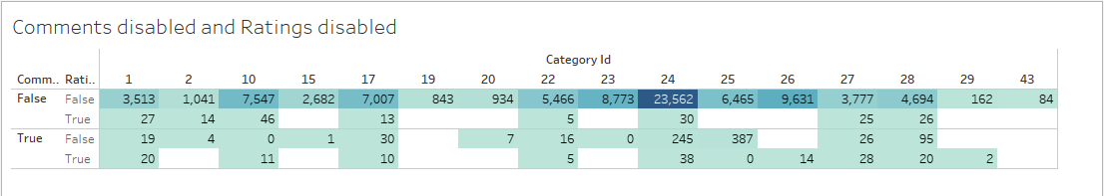
Comments and Ratings Disabled
This highlighted table shows the disabled Comments and Ratings as True and False according to the
Category ID.
The fields in various colours shows the True or false data at different points.

Slide 11
CONCLUSIONS
From all the above slides and data we can conclude that:-
The category with Category ID 24 has the highest Trend Day Count.
The category ID 24 has the highest number of likes as well as dislikes.
The category I 43 has the lowest amount of likes and dislikes.
We can say that the count of YouTube subscribers have increased from 2016 to 2018, and reached a maximum in the year 2018.
The subscriber count was the lowest during 2006 to 2015.
The years 2017 and 2018 have the highest subscriber count and 2006 has the lowest.
Similarly, like the previous charts, we can say that the category Id 24 has the highest Tag count.

Slide 12
EXECUTIVE SUMMARY
In this project we performed EDA for analyzing and investigating this data set and to summarize its main characteristics, and creating dashboard using visualization methods.
This Tableau Capstone Project is further explained :-
https://drive.google.com/file/d/18QNd73dWvBewxc4csRlY6SX9WYZVLk8J/view?usp=sharing

Slide 13


